Slide 1

“You’ve got to be very careful if you don’t know where you’re going, because you might not get there.”
Yogi Berra

Slide 2


Slide 3
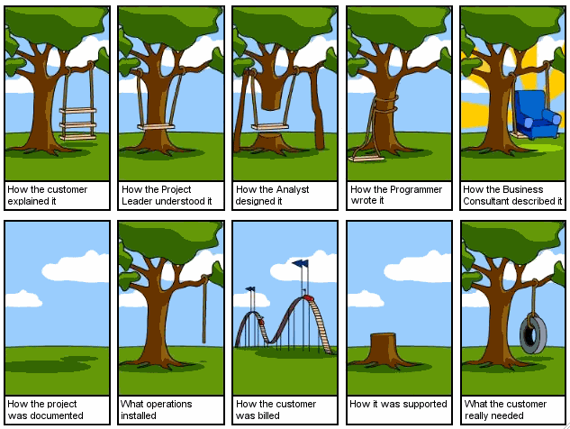

Slide 4

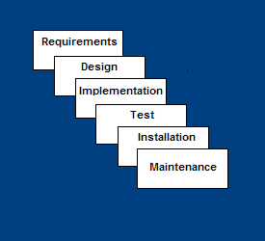
Requirements – decide on the software’s function, performance requirements (e.g. speed) and the UI
Design – algorithms, mathematical models, data structures, class structure, plan the user interface using drawings
Implementation – coding, building databases

Slide 5
Test– Run test cases, hire beta-testers to try it, fix bugs
Installation– Deliver the software as a downloadable product, or install it on your own company’s system
Maintenance– Release patches and software updates, provide customer-support by phone or online

Slide 6

Traditional: it’s what everyone is used to
Easy to understand, easy to use
Provides structure to inexperienced staff
Milestones are well understood
Easy for managers to control (plan, staff, track)
Works well when quality is more important than cost or schedule

Slide 7

All requirements must be known upfront
Deliverables at each phase are frozen – inhibits flexibility
Can give a false impression of progress
Does not reflect problem-solving nature of software development – iterations of phases
Testing is one big bang at the end
Little opportunity for customer input except at the end, when it may be too late

Slide 8

Requirements are well known
Product definition is stable
Technology is well understood
New version of an existing product
Porting an existing product to a new platform.

Slide 9
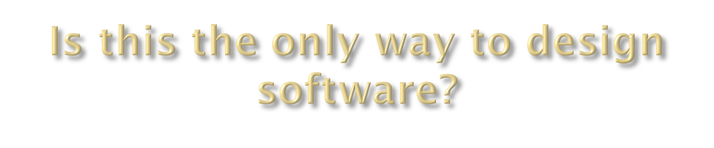
Two other models are gaining popularity:
  Evolutionary Prototyping
  XP (extreme programming)

Slide 10

Developers build a quick prototype
(in weeks, not months)
Prototype is evaluated by customers
Users give corrective feedback
Developers refine the prototype
Repeat until the users are satisfied
Finally, the prototype is brought up to the standards needed for a final product.

Slide 11

Customers “see” the requirements as they evolve
Developers learn from customers
A more accurate end product
Unexpected requirements accommodated
Allows for flexible design and development
Steady, visible signs of progress

Slide 12
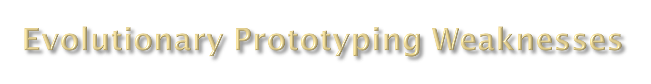
Tendency to abandon structured programming for “code-and-fix” development
Programmers may become sloppy
(“Don’t worry, we can always fix it later”)
Users don’t always know what they want (because they don’t even know what’s possible with today’s technology.)
Process may continue forever (scope creep)

Slide 13

Requirements are uncertain
As the requirements stage of a waterfall model
To help develop the user interface
Quick demonstrations

Slide 14
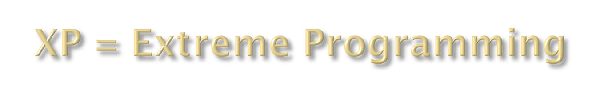
For small-to-medium-sized teams developing software with vague or rapidly changing requirements
Coding (rather than planning or meetings) is the key activity throughout the project
Communication among teammates is done with code, not talking

Slide 15

Small releases – put a simple system into production, then release new versions in very short cycle
Metaphor – all development is guided by a simple shared story of how the whole system works
Simple design – system is designed as simply as possible (extra complexity removed as soon as found)
Testing – programmers continuously write unit tests; customers write tests for features

Slide 16
Pair-programming -- all code is written with two programmers at one machine
Collective ownership – anyone can change any code anywhere in the system at any time
Continuous integration – integrate and build the system many times a day – every time a task is completed
On-site customer – a user is on the team and available full-time to answer questions
Coding standards – programmers write all code in accordance with rules emphasizing communication through the code

